Slide 1
PTSD risk calculator
10.1.19

Slide 2
The task
Original data – 1103 subjects, 179 columns
PCL3 strict == 0 is 681
PCL3 strict == 1 is 44
☹

Slide 3
Describe data
Missing data column – 0.5 threshold
Missing data row – 0.9 threshold (None)
Features: 64
Strafiied train test split – 0.15 test

Slide 4
Features

Slide 5
Few features groups
Time dependent features:
Only T1 & T2
Coping mechanimsms
Psychological isssues
- Dot probe
Unifomal features:
Genes
Army
Demographic
others

Slide 6
Time dependent features
Coping mechanimsms:
"active_coping", "planning", "positive_reframing", "acceptance", "humor", "religion", "emotional_support", "instrumental_support", "self_distraction", "denial1, "venting”, "substance_use”,"behavioral_disengagement", "self_blame",

Slide 7
Time dependent features
Psychological isssues:
"state”, "trait", "lot “, “phq", "PCL”

Slide 8
Time dependent features
Dot probe:
"T1Acc1t", "T1Acc1n", "T1bias"

Slide 9
Unifomal features
Genes :
"HML_5HTT", "HL_MAOA", "HML_NPY“, "HML_FKBP5"

Slide 10
Unifomal features
Army :
"COMT_Hap1_recode", "COMT_Hap2_recode“, "military_exposure_unit“, "COMT_Hap1_LvsMH"

Slide 11
Unifomal features
Demographic :
"Ashken_scale", "Sephar_scale", "Unknown“, "age", "highschool_diploma", "Hebrew

Slide 12
Unifomal features
others :
"dyslexia", "ADHD", "T1ETBE“, "trauma_history8_1“
"ptgi2", "cd_risc1"

Slide 13
Imputation & scaling
Mean imput…
No scaling

Slide 14
Feature selection

Slide 15
Feature engineering
Deltas
Interactions
Only Little bit helped…

Slide 16
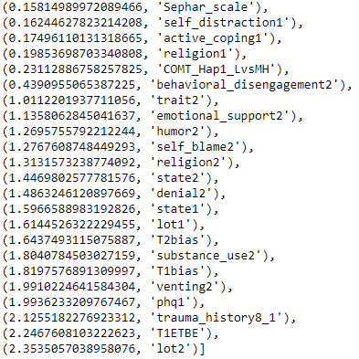
PCA
Our PCA with 0.99 explained variance:

Slide 17
SMOTE

Slide 18
Algorithm evaluation

Slide 19
F1 Score

Slide 20
Pipline
Impute missing data
PCA transformation
SMOTE
Get cross validation score
Get training error
Get calibrated probabilities

Slide 21
List of the algorithms
Logistic Regression
Random Forest

Slide 22


Results logistic regression
Without SMOTE –
With SMOTE –

Slide 23

Results Random Forest
With SMOTE –

Slide 24
Calibrated probability
Random forest –
LogReg – almost direcedly

Slide 25

We want simple calculator
RF without T2 features
Results:

Slide 26

We want simple calculator
RF with 15 most important PCA features
The features- '['T1ETBE’, 'T1bias’, 'T2bias’, 'state1’, 'state2’, 'trait1’, 'trait2',
'phq2’, 'PCL1’, 'PCL2’, 'cd_risc1’, 'ptgi2’, 'Ashken_scale’, 'Sephar_scale’, 'Unknown']
Results:

Slide 27
What’s now?
Code review
Grid search & other algos
Clustering & unsupervised learning

